Slide 1


HR Compensation Analysis
Alison Inglis
This Photo by Unknown Author is licensed under CC BY-NC

Slide 2
Agenda
Company Goals
Employee Tiers
Strategies
Solution

Slide 3


Company Goals
INCREASE GROSS REVENUE TO $1 BILLION
INCREASE NET REVENUE TO $750 MILLION

Slide 4
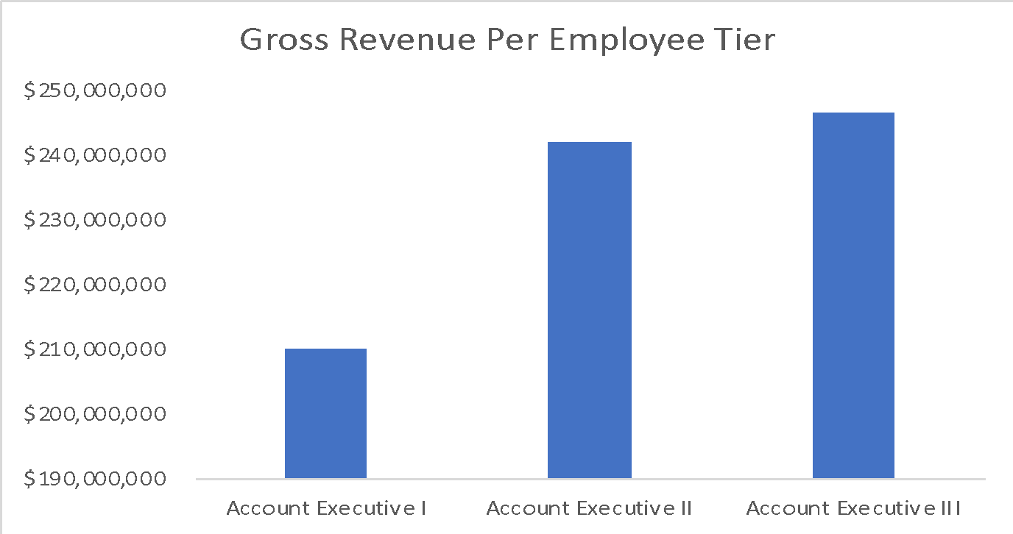
Gross Revenue Per Employee Tier
Notes:
Gross Revenue per Employee Tier increases as account executive tiers increase. There’s a more drastic difference in gross revenue between AE I compared to the other AE tiers. So perhaps HR can create more training and support for AE Is to ensure they get promoted more quickly If they are promoted faster and help grow more revenue for the company.

Slide 5
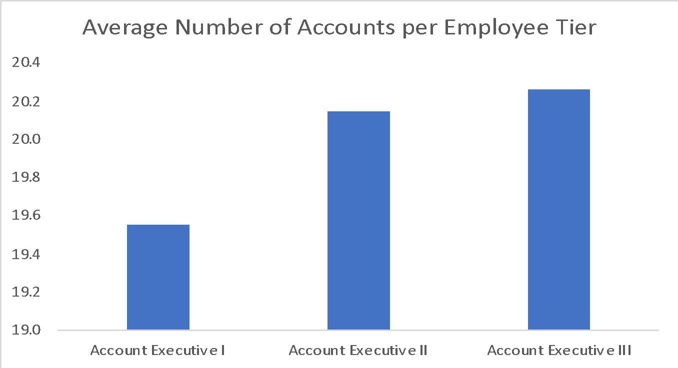
Average Number of Accounts Per Employee Tier
Notes:
Gross Revenue per Employee Tier increases as account executive tiers increase. There’s a more drastic difference in gross revenue between AE I compared to the other AE tiers. So perhaps HR can create more training and support for AE Is to ensure they get promoted more quickly If they are promoted faster and help grow more revenue for the company.

Slide 6
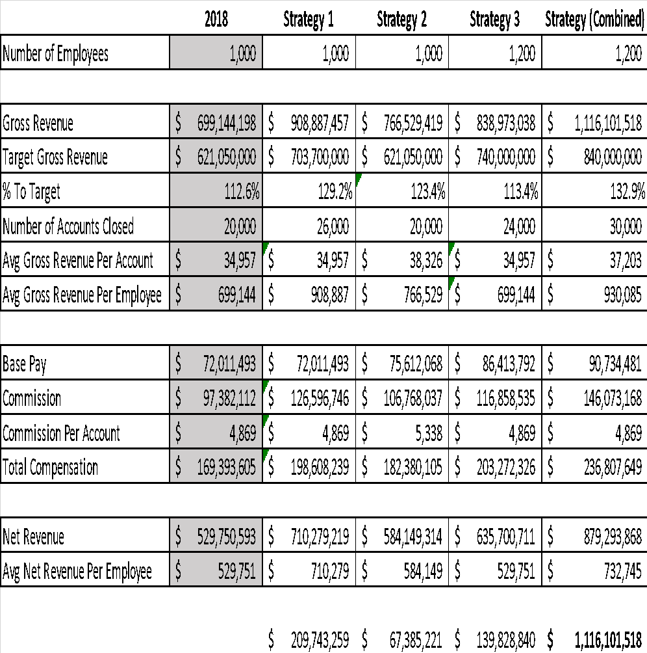
FY 2019 Workforce Planning

Slide 7

FY 2019 Workforce Planning

Slide 8
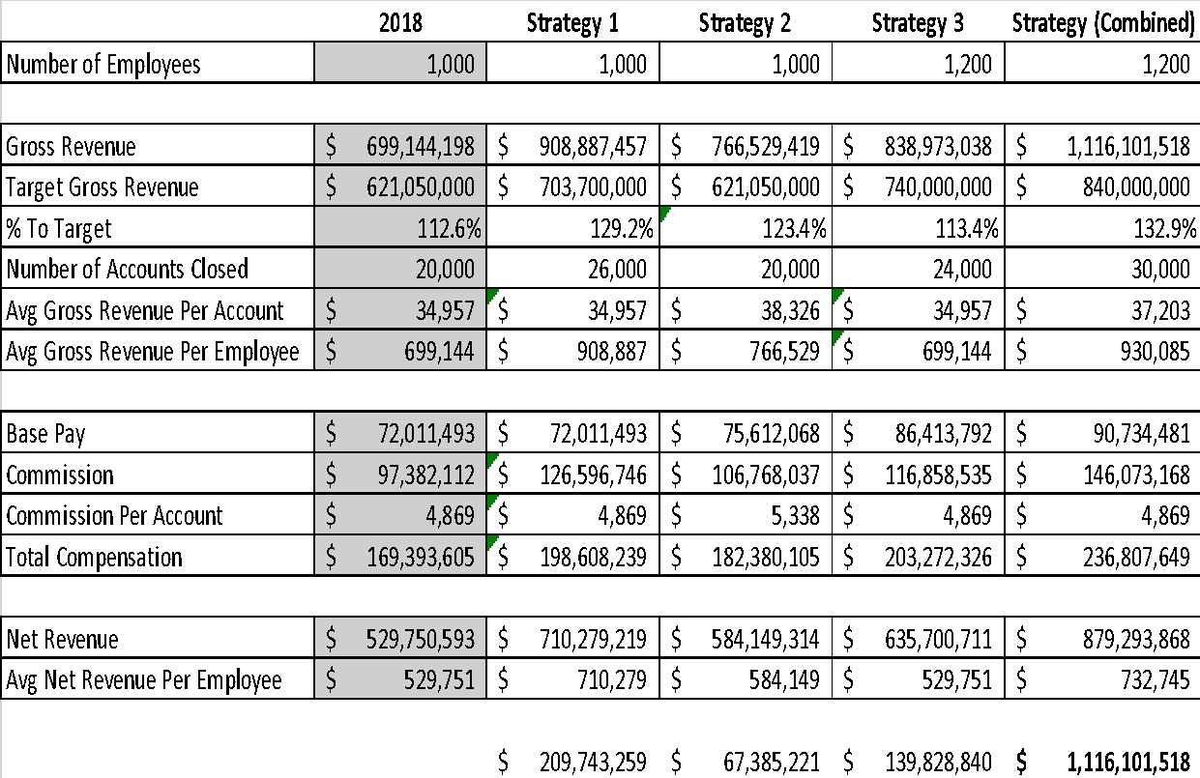
FY 2019 Workforce Planning

Slide 9
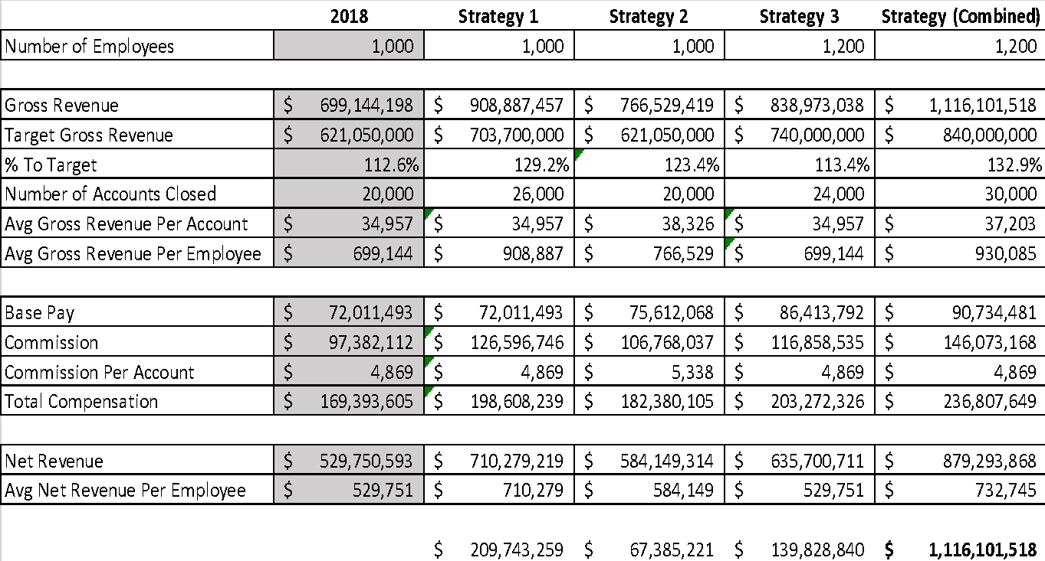
FY 2019 Workforce Planning

Slide 10

FY 2019 Workforce Planning

Slide 11
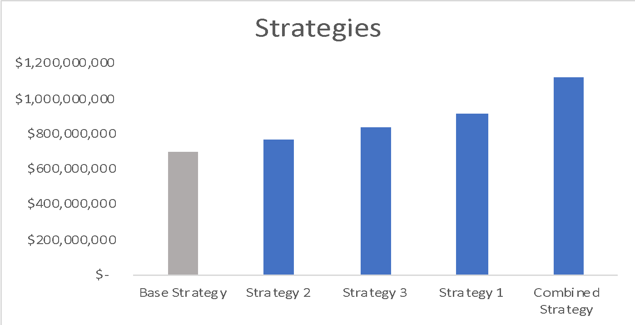
Gross Revenue - Strategies

Slide 12

Solutions
Grow business
Modify pay structure
Hire more
Support Account Executive I
Mentorship

